Slide 1
Q1. For the following IP Addresses-
1.2.3.4
10.15.20.60
130.1.2.3
150.0.150.150
200.1.10.100
220.15.1.10
250.0.1.2
300.1.2.3
Identify these
A. Class,
B. Network IP Address,
C.Direct broadcast address
D.Limited broadcast address of each IP Address.

Slide 2
Q .2 A block of addresses is granted to a small organization. We know that one of the addresses is 205.16.37.39/28. What is the first address in the block?
Solution

Slide 3
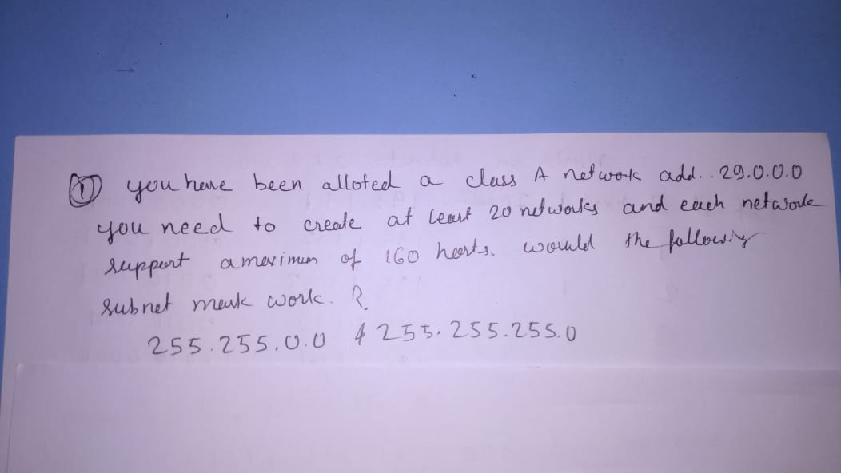

Slide 4
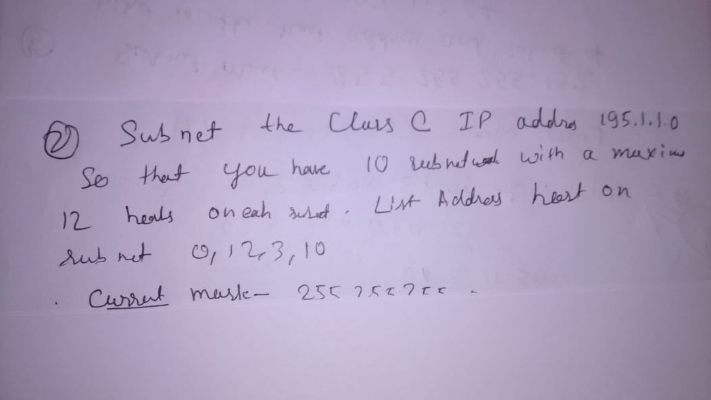

Slide 5
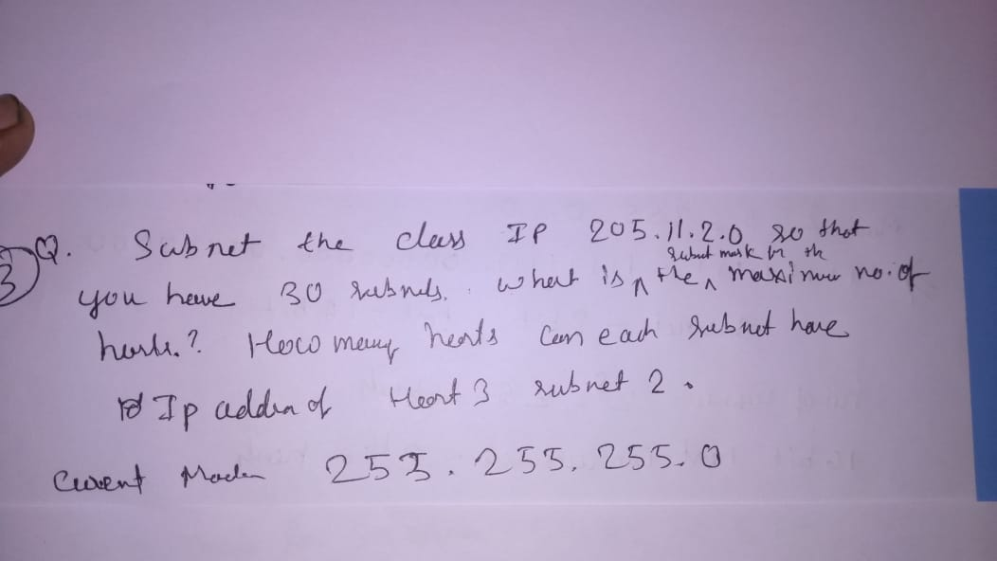

Slide 6
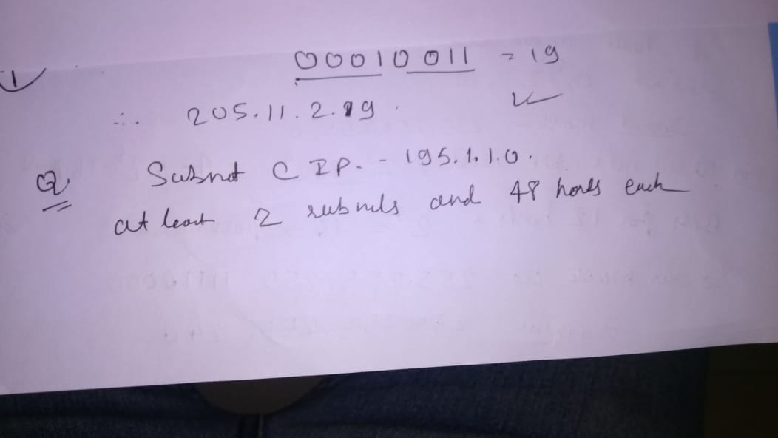

Slide 7
